Slide 1

Module 3: Working with Local Data

Slide 2

Overview
Using DataSets
Using XML
Using SQL Server CE

Slide 3
Lesson: Using DataSets
ADO.NET Model
Creating a DataSet
Filling the DataSet
Persisting the DataSet as an XML File
Binding to a DataSet
Using a DataGrid

Slide 4

ADO.NET Model
.NET Data Provider
DataSet
Tables
Connection
DataAdapter
Transaction
DataTable
SelectCommand
DataRowCollection
Command
InsertCommand
DataColumnCollection
Parameters
UpdateCommand
ConstraintCollection
DataReader
DeleteCommand
DataRelationCollection
Database
XML

Slide 5
Creating a DataSet
Dim myDS As New DataSet("Project")
Dim myDT As DataTable = _ myDS.Tables.Add("Task")
myDT.Columns.Add("Name", _
System.Type.GetType("System.String"))
myDT.Columns.Add("Start", _
System.Type.GetType("System.String"))
myDT.Columns.Add("Duration", _
System.Type.GetType("System.String"))
DataSet
DataTable

Slide 6
Filling the DataSet
Dim myDR As DataRow = _
myDS.Tables("Task").NewRow()
myDR("Name") = "Design Code"
myDR("Start") = "2/1/2003"
myDR("Duration") = "2 days" myDS.Tables("Task").Rows.Add(myDR)
Name | Start | Duration
Design UI | 1/1/2003 | I day
Design Code | 2/1/2003 | 2 days

Slide 7

Practice: Using DataSets to Access Data
1
Creating and filling a DataSet
2
Adding to a DataSet from a form

Slide 8
Persisting the DataSet as an XML File
DataSet provides volatile storage
Use the WriteXml method to save data
Use the ReadXml method to populate data from the file
myDataSet.WriteXml("win\tmp.xml")
Dim myDataSet As New DataSet()
myDataSet.ReadXml("win\tmp.xml")

Slide 9
Practice: Persisting the DataSet as XML
1
Save a DataSet as an XML file
2
Verify the XML file

Slide 10
Binding to a DataSet
DataSource property
  Binds a control to the data source
  Provides link from mobile application to DataSet
Dim dt As DataTable = _
tmpDS.Tables("Info")
'Bind to the list box
listBox1.DataSource = dt
'Set column to bind to
listBox1.DisplayMember = "Name"

Slide 11
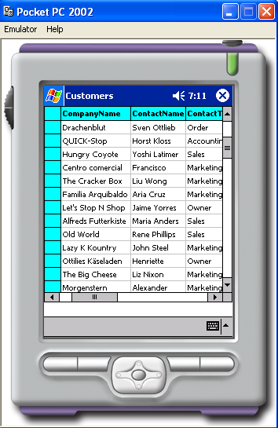
Using a DataGrid
Provides a user interface
for entire tables in a DataSet
Rich formatting capabilities
DataGrid is bound to a data source at run time (not design time)

Slide 12
Practice: Binding a Control to a DataSet
1
Binding a control to a DataSet
2
Verifying the binding

Slide 13
Lesson: Using XML
Supported XML Classes
Building an XmlDocument
Reading an XmlDocument

Slide 14
Supported XML Classes
XmlTextReader and XmlTextWriter
  Forward-only parsers of XML data
  Better performance because there is no in-memory caching
XmlDocument
  Data can be read into the object
  After modification, data can be read from the object back to a stream

Slide 15
Building an XmlDocument
Private Function BuildXmlDocument() As XmlDocument
Dim myXmlDoc As New XmlDocument()
Dim NewNode As XmlNode
NewNode = myXmlDoc.CreateElement("Project")
myXmlDoc.AppendChild(NewNode)
NewNode = myXmlDoc.CreateElement("Task")
NewNode.InnerText = "Write Code"
myXmlDoc.DocumentElement.AppendChild(NewNode)
Return myXmlDoc
End Function
<Project>
<Task> Write Code </Task>
</Project>

Slide 16
Reading an XmlDocument
XmlDocument is an in-memory DOM tree
Navigate DOM using properties and methods of XmlNode class
Values of nodes can be extracted and manipulated
Private Sub DisplayXmlDocument(myXmlDoc As XmlDocument)
Dim oNodes As XmlNodeList = _
myXmlDoc.DocumentElement.ChildNodes
Dim sbXMLDisplay As New StringBuilder()
Dim TaskNode As XmlNode
For Each TaskNode In oNodes
Dim PropertyNode As XmlNode
For Each PropertyNode In TaskNode
sbXMLDisplay.Append((PropertyNode.Name + ": " + _
PropertyNode.InnerText + ControlChars.Lf))
Next PropertyNode
Next TaskNode
MessageBox.Show(sbXMLDisplay.ToString())
End Sub

Slide 17
Practice: Adding an Element to an XmlDocument
1
Add an element to an XmlDocument
2
Verify that the element is added

Slide 18
Lesson: Using SQL Server CE
SQL Server CE Storage Architecture
Working with SQL Server CE
Using SQL Server CE Query Analyzer
Using a SQL Server CE Data Connector
Filling a DataSet from SQL Server CE
Using Parameterized Queries
Reading Data
Updating SQL Server CE from the DataSet

Slide 19


SQL Server CE Storage Architecture
.NET Compact Framework Managed Stack
SQL Server 2000
Visual Studio .NET (Visual Basic .NET, C#)
ADO.NET
SQL Server CE Data Provider
.NET Compact Framework runtime
Server
OLE DB for Windows CE
SQL Server CE
Data Provider
IIS
Server Agent: Replication and RDA
QP/Cursor Engine/ES
HTTP
Client Agent: Replication and RDA
Storage Engine/
Replication tracking
Client

Slide 20
Working with SQL Server CE
Available database storage in Pocket PC is limited
SQL Server CE 2.0 Features (see list in Student Notes)
Visual Studio .NET automatically configures development environment for use with SQL Server CE
  SQL Server CE 2.0 is included with the installation of Visual Studio .NET
  Must still configure IIS and Windows CE-based device
Installing SQL Server CE on the client device
  Add a reference to System.Data.SqlServerCe
  – or –
  Manually copy and extract core platform CAB files

Slide 21
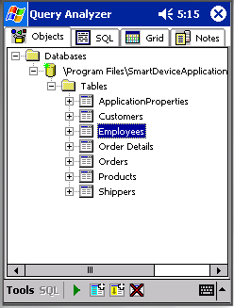
Using SQL Server CE Query Analyzer
A
Tap to execute a SELECT * FROM
Employees statement
B
Tap to add a column to the
Employees table
C
Tap to create an index on the
Employees table
D
Tap to drop the Employees table
A
B
C
D

Slide 22

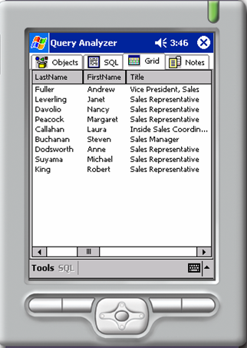
Demonstration: Using the SQL Server CE Query Analyzer

Slide 23
Using a SQL Server CE Data Connector
Connection string to SQL Server requires a database provider
SqlConnString = "Provider=sqloledb;
Data Source=London;
Initial Catalog=Northwind"
Connection string to SQL Server CE is similar, but a database provider is not specified
SqlCeConnString =
"Data Source=My Documents\Northwind.sdf"

Slide 24
Filling a DataSet from SQL Server CE
Establish a connection
Create a data adapter
Call the Fill method
Dim myAdapter As New SqlCeDataAdapter()
myAdapter.TableMappings.Add("Table", "Titles")
cn.Open()
Dim myCommand As New SqlCeCommand( _
"SELECT * FROM Titles", cn)
myCommand.CommandType = CommandType.Text
myAdapter.SelectCommand = myCommand
Dim ds As New DataSet()
myAdapter.Fill(ds)

Slide 25
Using Parameterized Queries
Parameterized queries
  Have built-in input validation
  Execute quicker and are more secure
' Insert data into the table.
SQL = "INSERT INTO Titles (TitleID,TitleName)
VALUES (?,?)"
cmd.CommandText = SQL
cmd.Parameters.Add("@TitleID",
System.Data.SqlDbType.NChar, 5)
cmd.Parameters.Add("@TitleName",
System.Data.SqlDbType.NVarChar, 40)
cmd.Parameters["@TitleID"].Value = "MSCF1"
cmd.Parameters["@TitleName"].Value = "Compact Framework"
cmd.ExecuteNonQuery()

Slide 26
Demonstration: Creating a Local Data Store
Create a SQL Server CE table
Populate the table

Slide 27
Reading Data
The ExecuteReader method runs the SQL or stored procedure and returns a DataReader object
The Read method moves the DataReader to the next record
Read must be called before data access methods are used
Dim reader As _
System.Data.SqlServerCe.SqlCeDataReader = _
cmdTxt.ExecuteReader()
While reader.Read()
MessageBox.Show(reader.GetString(0))
End While

Slide 28
Updating SQL Server CE from the DataSet
Save new or modified DataSet data to SQL Server CE
Update method updates the SQL Server CE table with changes made in the DataSet
myConn.Open()
Dim custDS As New DataSet()
myDataAdapter.Fill(custDS)
'code to modify data in dataset here
myDataAdapter.Update(custDS, myTableName)
myConn.Close()

Slide 29

Review
Using DataSets
Using XML
Using SQL Server CE

Slide 30

Lab 3: Working with Local Data
Exercise 1: Reading an XML File into a DataSet
Exercise 2: Appending Data to the XML File
Exercise 3: Saving Data to a SQL Server CE Table

